Slide 1

INVESTOR PRESENTATION
Confidential

Slide 2
Disclaimer
This investor presentation does not purport to be all-inclusive nor contain all the information, which a prospective investor may desire. Accordingly, you will be required to conduct your own independent due diligence of the Company prior to making any investment decision.
While, the information contained herein is from sources deemed reliable it has not been independently verified by the timefree.tv (hereby known as the 'Company'). Neither the Company, nor any of it officers, advisors, or their affiliates make any representation or warranty as to the accuracy or completeness of any of the information contained herein.
This investor presentation contains proprietary and material non-public financial information and other information relating to the business and affairs of the Company. This presentation may not be photocopied, or reproduced, or distributed to others except for on a need to know basis within your organization or to your advisors, provided however that they must agree to be bound by the terms of the Confidentiality Agreement with the Company prior to receiving this summary. Upon request, you agree to promptly return all information received from the Company (including this presentation) without retaining any copies and will destroy all analyses based in whole or in part of any such material.
Certain statements in this presentation constitute “forward-looking statements.” These forward-looking statements are not historical facts but rather are based on current expectations, estimates and projections about our industry, our beliefs and our assumptions. Words such as “anticipates,” “expects,” “intends,” “plans,” “believes,” “seeks,” “estimates,” “will,” and variations of these words and similar expressions, are intended to identify forward-looking statements. These statements are not guarantees of future performance and are subject to risks, uncertainties and other factors, some of which are beyond our control, are difficult to predict and could cause actual results to differ materially from those expressed, implied or forecasted in the forward-looking statements. In addition, the forward-looking events discussed in this summary might not occur. These risks and uncertainties also include, among others that will be more fully described in “Risk Factors” in the definitive documents between the parties. Readers are cautioned not to place undue reliance on these forward-looking statements, which reflect our management’s view only as of the date of this summary. Except as required by law, we undertake no obligation to update any forward-looking statement, whether as a result of new information, future events or otherwise.
The Company’s projected summary financial statements contained herein have been prepared in good faith based on the Company’s plans, the last several months of history, and management’s planned actions and the summary of significant assumptions which management believes are reasonable in light of known events and circumstances. Many of the assumptions are dependent on economic forecasting, both general and specific to the Company’s business, which are inherently uncertain and subjective. The Company’s plan is subject to significant business, financial, market, market acceptance, market penetration, economic, and competitive risks, and other risks, which are beyond the control of the Company. These factors could cause the Company to significantly alter its plan and thereby management’s planned actions and related summary of significant assumptions which might result in a material different outlook of the Company’s prospects in light of different future circumstances or events other than those anticipated.
The projected summary financial information herein reflects management’s projections as to possible future results based on a number of assumptions. These assumptions include the timing and success of market penetration based on customers’ acceptance of the Company’s services at the anticipated unit pricing, recruiting personnel demand at costs consistent with the projections, its ability to operate in line with the projected operating cost structures at the anticipated unit volume levels assumed in the projections, its ability to maintain management and attract new regional talent in-line with projected market penetration and costs, its ability to retain experienced management and add to it as the Company grows at compensation levels consistent with the projections, and maintain its services competitive edge against competitors. The assumptions involve significant elements of subjective judgment and analysis, and management does not represent or warrant whether they are accurate or attainable. The projected financial information should not be relied upon to indicate the actual results, which might be attained. Management did not prepare the projections with a view to public disclosure. Further, the projections do not comply with the published guidelines of the SEC or any state securities commission, or the guidelines established by the American Institute of Certified Public Accountants.
There can be no assurance that the Company will realize the projected results, even if the factors noted above do not adversely affect the Company. The projected results will vary from the actual results and the differences may be material. Accordingly, the Company nor its Advisor or any person makes any representation or warranty that the projections are accurate or that they will be realized. Further, neither the Company nor its Advisor assumes any responsibility or liability in regards to updating the projections after the date herein for any reason.

Slide 3
Business Objective
To stop viewers skipping adverts and re-engage them with advertising, creating a platform where we pay viewers to watch tv and video, allowing advertisers to reach the audience they want with deals and offers the viewer wants in conjunction with a go-to service for watching linear TV on tablets and smartphones
uniquely targeted advertising and consumer payments in one system
(And create a polished model for global replication)

Slide 4

The Proposition
To meet the needs of the three main contributors to successful commercial video based media. The viewer, the content provider and the commercial advertiser / sponsor.
A unique proposition for viewers, channels and advertisers
VIEWERS: get paid to watch their favourite content and participate in exclusive promotions
CONTENT PROVIDER: most popular content will attract the highest revenue, as it does now
ADVERTISERS: real-time targeting of adverts and ground-breaking interactive features

Slide 5
Why now ?
Huge shift in how and where people want to watch TV in an ever more connected world
“Catch-up” TV is booming – viewers are watching tv whenever and wherever they can
Tablets and phones are now television viewing devices
Advertisers do not have a service whereby they know who their audience are
Viewers looking to save costs and earn money, can watch premium content without setup or subscription fees
£3.9 billion linear TV ad market is chasing more targeting online video opportunities
Online video has not yet extended to replacing the linear ad breaks with viewer-level targeted ads. This has dis-incentivised channels from simulcast
OTT & multiscreen growth
2013 - Time spent watching tablet video grew 59%*
2013 – video viewing on phones increase by 41%*
2012 to 2017 - OTT revenues will grow globally by 23.2%*
Digital ad market change
2014 – 25% of all video spend will be RTB**
2015 – 57% growth in mobile video ad spend**
2016 – almost one third of digital spend will be on video**
source - * Ooyala **Google UK

Slide 6
Investment – To update !!
Founder shareholders have assembled all the key building blocks to deliver timefree.tv to the UK market representing a £MM investment
Perception – unique cloud multi-screen IPTV platform
Vision247 – channel head-end services and tier1 video delivery network
Axex – a programmatic ad sales platform
Touchcast – bringing interactivity within video
Existing technology and infrastructure assets of the founders are focused on B2B markets
Seeking external financial investor to facilitate the launch of timefree.tv as a consumer proposition leveraging these assets
£3M investment sought for 15% of the equity
£0.4M for additional development work around dynamic ad insertion and interactive video applications
£1.5M in cap-ex for the timefree.tv delivery platform up to cash flow breakeven
£0.4M in working capital up to cash flow breakeven [ base scenario ]
Exit sought via trade sale within 3 years
Base plan: 1.25M active users by Y3 (3.5% UK market) generating EBITDA of £10M. Sale multiple of 8 delivers IRR of 97%
Stretch plan: 2.1M active users by Y3 (6% UK market) generating EBITDA of £19M. Sale multiple of 8 delivers IRR of 174%

Slide 7
Core founder competencies
USP Networks has innovated with all aspects of IPTV since 1995 (Vxtreme), and worked with all the evolving and major technologies
First to operate “direct to desktop” business IPTV services via satellite and DSL in 2000, including a network PVR with catchup EPG (EnfoCast) The descendant of that service (“tvserver”) is presently in use for corporate comms, training and research in organisations such as the Bank of England and JP Morgan
First to create a framework for rewards-based video advertising in 2003 with “incenTV”
First to demonstrate interactive video commercials using TouchCast technology – and bringing that technology to timefree.tv to create a showcase example
USP are also pioneers of scalable cloud based computing and developers of complex data management and analysis systems
USP holds a joint patent in the field of audience targeting that complies with the most stringent EU privacy regulations, and has evolved other associated IP in this area since 2003.
COMMERCIAL PROCESSES
Channel licensing
Axex ad sales system
Perception IPTV platform
Touchcast interactive platform
SERVICE DELIVERY PLATFORM
Channel downlink & encoding
Tier 1 CDN
IncenTV
timefree.tv
Engagement Analytics
Viewer incentive Vouchers
Touchcast platform
Payments
Touchcast license fee
Attach value
to advert responses
See where and
when the audience
engages
License fee

Slide 8
Commercial Strategy
Commercials: Can be viewer targeted, adverts do not have to be delivered in the broadcast (or on demand) programme stream, adverts can replace broadcast adverts in real time. Game shows for instance have periods of inactivity when viewers could be earning rewards
Rewards: Adverts can be interactive, can play full screen or in windows, can carry incentive ‘e-vouchers’, e-vouchers can link directly to store loyalty schemes
Save Time: Time is precious, don’t waste it watching the same old intros and exits, use it to offer reward commercials, viewers can opt to watch commercials that overlay repeated show intro and credit sequences and save money whilst doing it
Dynamic: e-Vouchers can be dynamic with reminders which can be inserted in various formats, including an initial offer value which drops over time, the quicker you click the bigger your reward
Betting: Parental safeguard betting or bet using loyalty points or fantasy games, allowing friends to play agains each
All of which are useful sources of information

Slide 9
Features
Peer recommendation: It’s huge, which means the best sales people are going to be viewers who want to show IncenTV to their friends. Rewarding the viewers to spread a powerful money saving message, using classic referral marketing
Rewarding Response: Viewers are asked to profile themselves, individually and as a family profile if needed. The more they are willing to share, the more they can make. Advertisers offer vouchers that will get responses from the viewer, pressing the green button or tapping the screen saves the voucher to their loyalty account. Some bigger ticket items could include commissions paid to the introducer of the incentive to a friend
Example Commission Path: Customer Mark subscribes to IncenTV and then encourages his friend Kate to subscribe. Mark receives a £10 sign up bounty.
Research tells us that Kate has a 8 year old washing machine, so Zanussi pays to send Kate a commercial with a £20 off voucher. Kate takes the offer and ultimately buys the productusing the voucher, Mark receives a £5 commision paid into his IncenTV account

Slide 10
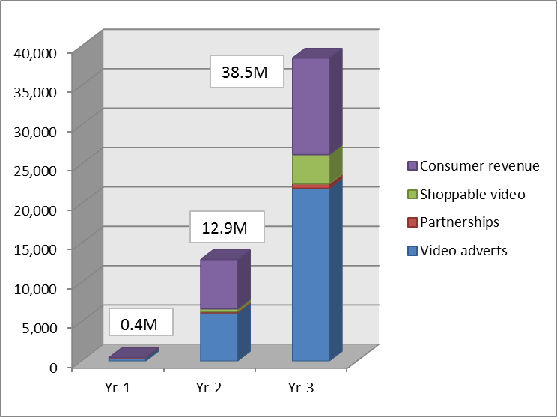
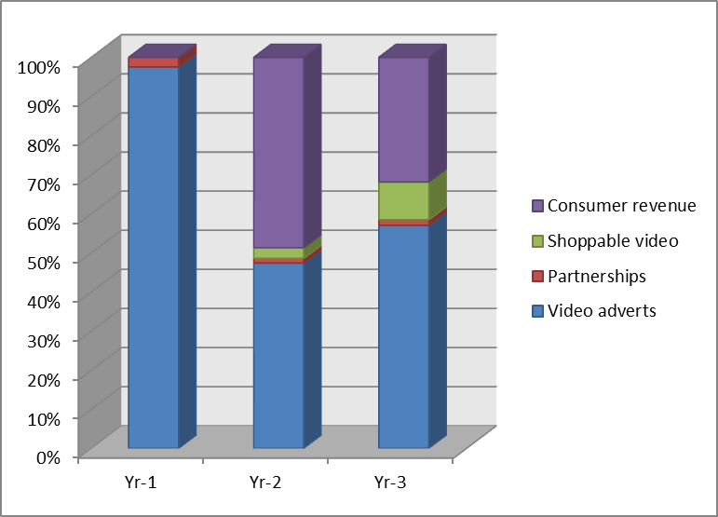
Generating revenue – To update!!
Video advertising
Pre-roll on all channels. Does not require commercial agreement with the channel
Dynamic replacement of in-stream ad breaks forecast from month 7 onwards after development work delivered
120 minutes per month average viewing rising to 495 after 3 years
Average gross CPM assumption is £18 with fill rate rising from 65% to 85%
Shoppable video
Commercials where viewers interact directly with content
The timeline of interactions is recorded for analysis
Actions such as “buy now” or “collect voucher” are possible
Consumer revenue
Forecasting blended ARPU from viewers of £1.02 per month
Range of commercial services including premium ethnic content, no-pre roll ad service and gaming.
Incremental ad opportunities
Dedicated bespoke timefree.tv advertiser CRM strategy
Sponsorship & Display solutions via premium niche targeting
Exclusive gaming ‘360’ commercial arrangements
Equity / Per Invoice exchange for remnant inventories
Revenue growth
Revenue
mix
Base revenue scenario:

Slide 11






Dynamic Insertion
Becomes
In-channel ad breaks: same ads seen by every viewer. No additional revenue generated from online viewing
In-channel ad breaks: different ads seen by different viewers. New revenue generated from online viewing

Slide 12
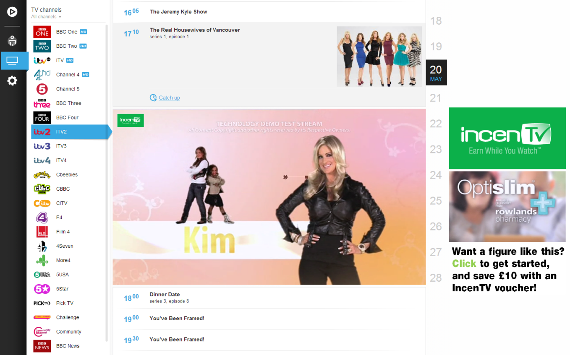
Shoppable Video
Touchcast technology allows viewers to interact directly with commercials …

Slide 13
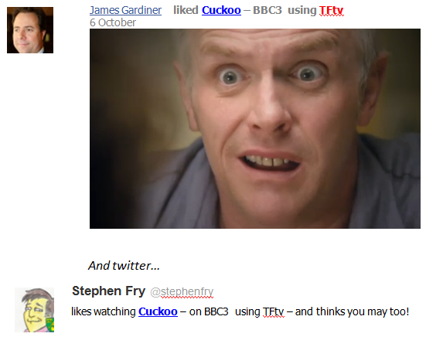
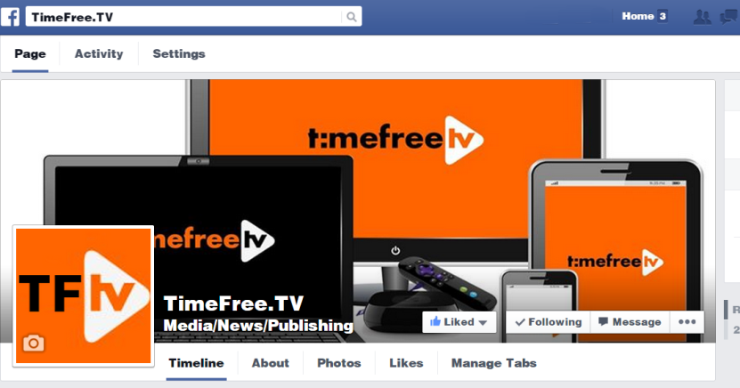

Social Media Engagement
IncenTV users can post links to programmes they are watching – or have watched – or plan to watch – to their friends and followers

Slide 14
Dev-ex
Direct route to advertisers
IncenTV is the ideal way to communicate with customers in offset or real time
Content may be live or recorded – but ads are real time
IncenTV is an ideal platform for local advertising
IPTV also powers on-demand (and live) interactive shopping channels at low cost compared to any traditional broadcast
Example: overstocked with lemons in the Chelmsford store? Then push “a hundred and one things Jamie Oliver can do with a lemon” to viewers in CM1-CM3 postcodes…
Touchcast integration
TouchCast video uses a standard MP4 format plus a synchronised XML “track” that provides location and timing information for the video apps “Vapps” that provide interaction
Suitable Players for PC (Chrome), iOs and Android are available and will be switched as needed.
A key differentiator is the analytics process that allows advertisers to track how viewers interact with their commercial, these are recorded at the server at the time the TouchCast is being viewed.
Development expenditure is budgeted at £200,000

Slide 15
Future advertising
Advertising evolution However, scheduled broadcasting is with us for while longer, so let’s “embrace” that as an opportunity
You spot an advertising screen somewhere in public – a rail station, shopping mall etc.
A TV programme trailer is shown and the screen shows an optically “grabbable” code (or use NFT) and the screen ID #
Just “snap” the code or enter those numbers on your handset, dial the number displayed, and IncenTV will record that show for you on your “cloud PVR”.
What did you just do?
You sent a message to record a show on your IncenTV Cloud PVR (or your grandmother’s) from anywhere on the planet
And you also provided priceless marketing information to the programme provider that will enable them sell the commercial opportunities in and around that show on the basis of understanding the audience before the show air, not just afterwards (as provided with current TV audience ratings systems)

Slide 16
Business Model – To Update!!
Many possible revenue streams, including
Licensing of platforms and elements thereof
Supply of core server solutions
Operation of required infrastructure
Management of interactive advert platforms
Operation of advert and EPG position auctions Management and sale of metadata arising
Creation of “Active Adverts”
Sales of content; licensing IPR

Slide 17
Consumer marketing To Update!!!!
Stage 2 – month 6 – 36
Launch vertical market exclusive’s, via blue chip brands with large customer bases and a synergy with TFtv to develop more targeted ad’s and interactive promotion
TFtv at Morrisons, Vodafone’s TFtv, Daily Mail in association withTFtv…. providing co branded TV, offer ability to expand online experience into dedicated TV channel
Offer ad community supporting the above, a better return via dynamic insertion, inventory re-use in catch-up, direct access to targeted communities, interactive promotion that forces a route to buy online or in-store
Refocus consumer viral campaigns across social, retail and entertainment media
Feed into vertical market activity, focus messaging that relates to Morrison’s customer base or Daily mail readers.
bolster the messaging that challenges the way we watch TV, how do consumers get more out of the ad’s they are supposed to watch. Focus on the potential to instantly respond etc.
Solidify TFtv’s direct to consumer proposition through International content
Add international community channels through existing and new, live and on-demand content acquisition. Promote through international community media using viral marketing and focused campaigns
Marketing budget – see financial plan
Fixed element will deliver corporate requirements and launch campaign
Variable element will primarily support channel development, driven by funding timing, cash flow, vertical channel development success and the user growth against target.

